Slide 1


Korean e-Navigation project
SMART-Navigation
Presented by
Sewoong OH (KRISO)
December. 2016

Slide 2
⁰¹
^{e-Navigation}
⁰²
^{SMART-Navigation}
⁰³
^{Strategy of SMART-Navigation}
⁰⁴
^{Roadmap}
⁰⁵
^{Benefit of SMART-Navigation}

Slide 3
⁰¹
^{e-Navigation}
e-Navigation is …
Definition of e-Navigation (by IMO)
“E-navigation is the harmonized collection, integration, exchange, presentation and analysis of marine information on board and ashore by electronic means to enhance berth to berth navigation and related services for safety and security at sea and protection of the marine environment”, IMO MSC 85/26/Add.1
‘e’ of e-Navigation means…
‘e’ could have stood for ‘enhanced’ or ‘electronic’, but this would unnecessarily limit

Slide 4
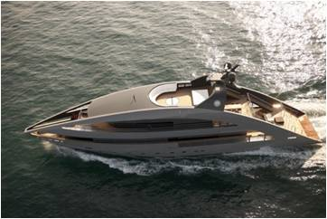
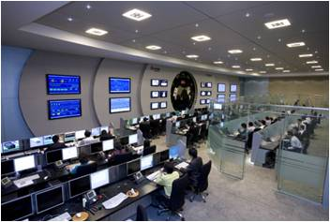
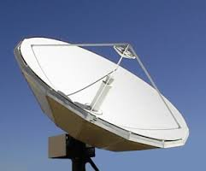
⁰¹
^{e-Navigation}
Key elements of e-Navigation
Ship
Shore-based
New generation’s ECDIS
Integrated Bridge System
Ship Area Network
Device for small craft
e-Navigation
Maritime Cloud service
Maritime Big-Data
Ship Monitoring System
Network
Maritime LTE Network
Digital GMDSS Network

Slide 5


⁰²
^{SMART-Navigation}
SMART-Navigation is …
Total Maritime Safety Management System utilizing Digital Communication system
SMART-Navigation
Taking into consideration special maritime environment in Korean Coastal Waters
IMO
e-Nav
e-Nav Services for non-SOLAS ships
SMART-Nav
=
+

Slide 6
⁰²
^{SMART-Navigation}
SMART-Navigation is …
Aim
SMART-Navigation aims at
WIDER CONNECTION, SMARTER NAVIGATION
Basic Information
Project Name: SMART-Navigation Project
Organized by: Ministry of Oceans and Fisheries, Republic of Korea
Lead partner: KRISO (Korea Research Institute of Ships & Ocean engineering)
Implementation period: August 2013 – December 2020
Budget: KRW 130 B (USD 116 M)

Slide 7


⁰²
^{SMART-Navigation}
SMART-Navigation Services
I M O M S P s | 1. VTS Information Service | 2. VTS Navigation Assistance Service
 | 3. VTS Traffic Organization Service | 4. Local Port Service
 | 5. Maritime Safety Information | 6. Pilotage service
 | 7. tugs service | 8. vessel shore reporting
 | 9. Telemedical Maritime assistance Service | 10. Maritime Assistance Service
 | 11. nautical chart service | 12. nautical publications service
 | 13. ice navigation service | 14. Meteorological information service
 | 15. Hydrographic & environmental information service | 16. Search and Rescue(SAR) Service
Korea’s specially designed service
For safety, economy, security and environmental protection in Korea
Essentially required service
Specialized service
Additional service not included in the preliminary list of MSPs but necessary
For Korea maritime safety management
e-Navigation service for coastal small ships, fishing vessel, leisure boat, etc
Remote monitoring for risk of collision, aground
Remote monitoring of ship's on-board sys.
Support for Optimized Safety Route
ECS Streaming service for small ship

Slide 8
⁰²
^{SMART-Navigation}
SMART-Navigation Services
SMART-Navigation project is focused on the Korean marine traffic environment providing the following services.
ID | Service | Target Vessels | Communication Method
S1 | Monitoring Assistance Service for high risk ships | Korean passenger ship (Domestic/International voyages) | LTE-M VDES
 |  | Korean dangerous cargo vessel
 |  | Korean ship for international voyages
S2 | Remote Monitoring on system onboard | Korean passenger ship (Domestic/International voyages)
 |  | Upon request | LTE-M, VDES/SAT
S3 | Optimal route planning | Korean passenger ship (Domestic/International voyages)
 |  | Upon request | LTE-M, VDES/SAT
S4 | Electronic Navigational Chart streaming for small vessels | Coastal vessel (Only for Domestic voyages) | LTE-M
S5-1 | Pilot/Tug Assistance Service | Pilot and Tug | LTE-M
S5-2 | Maritime Safety Information Service | Upon request | LTE-M, VDES/SAT

Slide 9
⁰²
^{SMART-Navigation}
SMART-Navigation Project
SMART-Navigation
S
Sea traffic coordination & optimization
M
A
Active & proactive maritime safety management
Maritime domain awareness
R
T
maritime Telematics
Remote Assistance
Activity 1 | Core Technology Development | Enabling comprehensive situational awareness & responding service(S1) | WP1 | Monitoring Assistance for high risk ships
 |  | e-Navigation service development covering Korean maritime traffic (S2/S3/S4) | WP2 | Remote monitoring on system onboard for high risk ships
 |  |  | WP3 | Optimal routes planning for high risk ships
 |  |  | WP4 | Electronic Navigation Chart streaming for small vessels
 |  | Developing essential services required by IMO e-Navigation(S5) | WP5 | Pilots/tugs assistance service
 |  |  | WP6 | Maritime safety information service (information on maritime safety, weather, route)
Activity 2 | Developing SMART-Navigation operating system & Digital maritime infrastructure |  | WP7 | Comprehensive operating system for e-Navigation
 |  |  | WP8 | Establishing high speed wireless maritime network(LTE-M)
 |  |  | WP9 | Establishing digital system for maritime wireless communication
Activity 3 | Leading Technology Development for global standardization |  | WP10 | Developing Maritime data standards(S-10X)
 |  |  | WP11 | Developing Maritime cloud
 |  |  | WP12 | Developing maritime wireless communication(standard) technology
 |  |  | WP13 | S-mode

Slide 10
⁰²
^{SMART-Navigation}
Korea`s Specially Designed Services
(1) Accident Preventing Service for the Vulnerable ships
Technology for Supporting Optimized Safety Route Vulnerable ships from
land, utilizing related information
Vulnerable ships ▼
E-Nav Operation System
Rescue Org.
Real time route info.
Coastal Passenger ship
Passage plan
Cal. For Optimized Safety Route
Coastal Tanker
Real time route info.
Aware risk of collision, aground
Ships around of Rescue operation
Coastal Cargo ship
Optimized route info.
Monitoring of Traffic

Slide 11
⁰²
^{SMART-Navigation}
Korea`s Specially Designed Services
(2) Real time Context Aware Monitoring Service
Total maritime traffic management technology for monitoring ship’s status(incline, fire, flooding, engine status), operation status, etc through information from ship and shore
Information
Big Data
Ship’s status
Ship’s status(Internet)
Real-time Monitoring

Slide 12
⁰²
^{SMART-Navigation}
Korea`s Specially Designed Services
(3) Customized service for Fishing vessel
Providing optimized service for fishing vessel to prevent maritime accidents
- Real-time monitoring of fishing vessel`s position
- Providing information of Sea temp, weather, tide, etc
Total Solution for Fishing Vessel
Weather info.
KMA
Safety Info.
Position information
Ships’s Info(PSN,etc)
Onboard information
Fishing Vessel
Sea temp. info
KHOA
Risk Analysis

Slide 13
⁰²
^{SMART-Navigation}
Korea`s Specially Designed Services
(4) Navigational Chart Service for Small ships
Provide Real-time Navigational chart service to Small ships
(Fishing vessel, leisure boat, etc)
Nav. Area, Ship’s info.
Before Dep.
e-Nav Operation System
Chart(Download in the ship)
After Dep.
Real-time PSN
e-Nav Operation System
Real-time Safety info, Chart update streaming service

Slide 14
⁰³
^{Strategy of SMART-Navigation}
Core Technology
Develop Core technologies on the service for SMART-Navigation
R&D
Total Maritime Traffic Management Tech.
R&D
Next Gen.
Maritime radio comm Tech.
R&D Leading International Standard
(S-10x, S-Mode)
Tech.

Slide 15


⁰³
^{Strategy of SMART-Navigation}
Infrastructure
Construct National Maritime Safety Infrastructure for realization of
SMART-Navigation
Construct total operation system for
e-Navigation
Construct Next Gen. Maritime radio comm. infrastructure

Slide 16
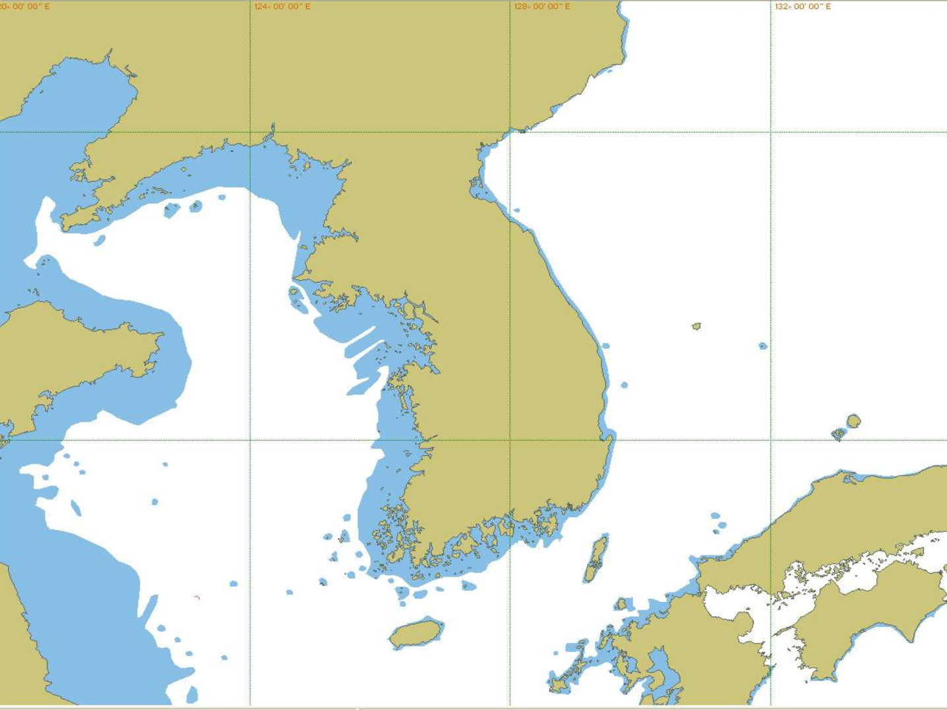
⁰³
^{Strategy of SMART-Navigation}
Infrastructure
China
China
Korea
Korea
Within 100Km = LTE-Maritime
100~300km = Digital GMDSS
Japan
Japan

Slide 17

⁰³
^{Strategy of SMART-Navigation}
Platform
Construct national system to achieve policy object related to marine
accident prevention and efficient port operation, promoting industry
01
02
Improvement system for
marine safety & Port operation
Development of maritime
safety industrial environment
03
04
Cultivating customized
Specialist with academic-industrial collaboration
Arrangement of
legislative system

Slide 18
⁰³
^{Strategy of SMART-Navigation}
Governance
National Co-operation & Operation System, Public relations,
International Co-operation System
01
02
Inter-ministerial Consultative Organization
Public-Private co-operation Partnership
03
04
Enhance International Network
Activate National Communication

Slide 19
⁰⁴
^{Roadmap}
SMART-Navigation Project Roadmap
2013
2016
2017
2019
2020
R&D
Developing relevant core Tech. & Services
Infrastructure
Construct the e-Navigation operation system &
Maritime Digital Infra(Communication system)
Conceptual design
Operation
Architecture of SMART-Nav
Organizing Governance

Slide 20




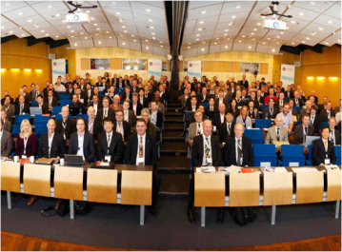


⁰⁵
^{Benefit of SMART-Navigation}
SMART-Navigation can achieve…
ㄹ\
2013
Safety
Efficiency
Reduction of 30% maritime accident rate
740
30%
Improvement of port productivity and efficiency
Ship fuel consumption
500
Port efficiency
2012
2030
30%
ㄹ\
Happiness
Creative
Solution for users at sea
New technology and expertise for international community

Slide 21
⁰⁶
Conclusion (Role of Hydrographic office)
Key actor for e-Navigation project
Ship <-> Network <-> Shore (VTS, PA, Met org, CG, Hydrographic Office…)
I M O M S P s | 1. VTS Information Service | 2. VTS Navigation Assistance Service
 | 3. VTS Traffic Organization Service | 4. Local Port Service
 | 5. Maritime Safety Information | 6. Pilotage service
 | 7. tugs service | 8. vessel shore reporting
 | 9. Telemedical Maritime assistance Service | 10. Maritime Assistance Service
 | 11. nautical chart service | 12. nautical publications service
 | 13. ice navigation service | 14. Meteorological information service
 | 15. Hydrographic & environmental information service | 16. Search and Rescue(SAR) Service
CMDS (S-100)
S-101 ENC
S-102 Bathy surface
S-104 Tidal height
S-111 Surface Current
S-112 Water level
S-124 Nav Warning
S-12X Nautical Pubs
S-412 Weather overlay
:

Slide 22
THANK YOU
If you need further information, please contact:
Dr. OH, Sewoong
osw@kriso.re.kr

